Slide 1
SAMPLE SPONSOR ADS
PBI’s 2019 Annual Conference

Slide 2

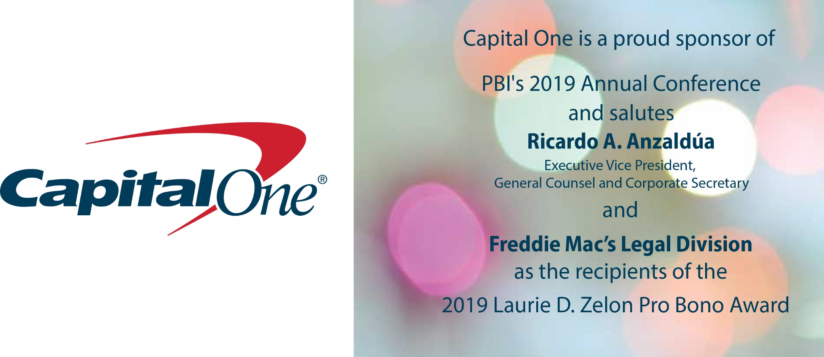

Slide 3
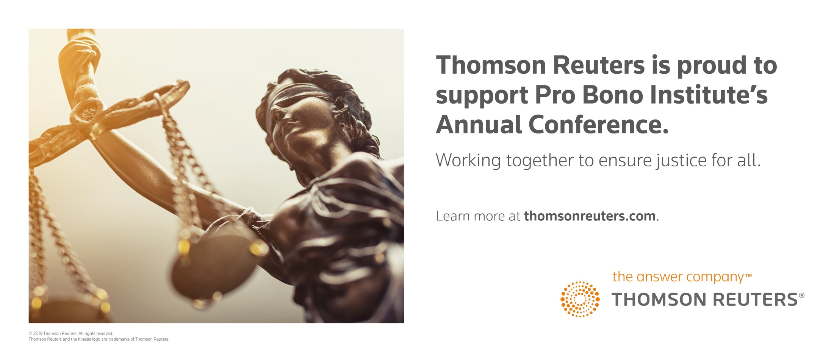

Slide 4



Slide 5



Slide 6

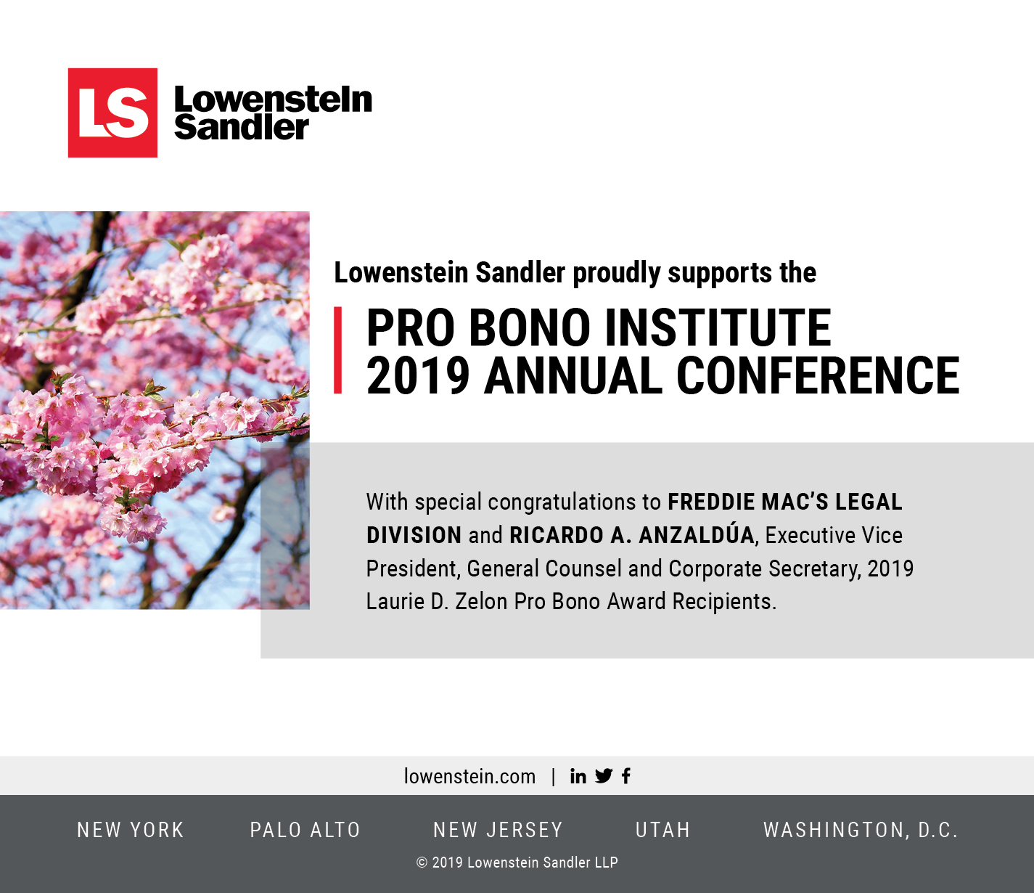

Slide 7
SAMPLE SPONSOR ADS
PBI’s 2019 Laurie D. Zelon
Pro Bono Award Luncheon

Slide 8
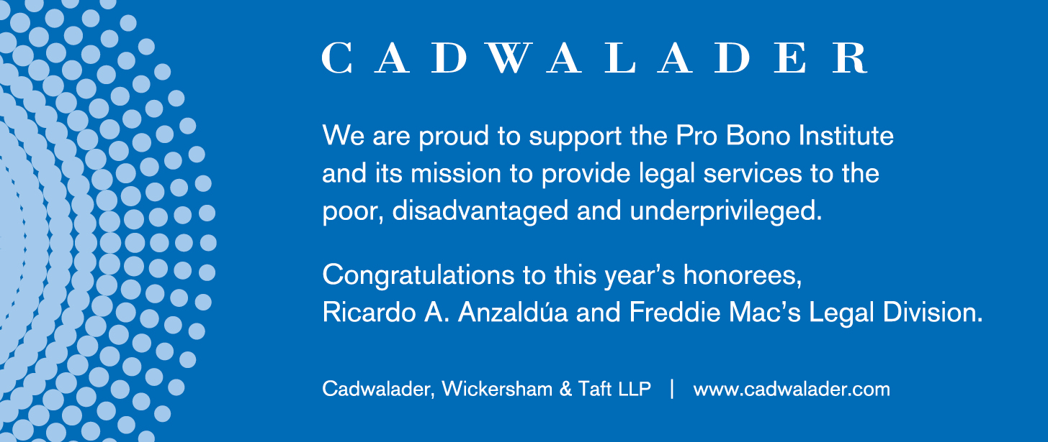

Slide 9
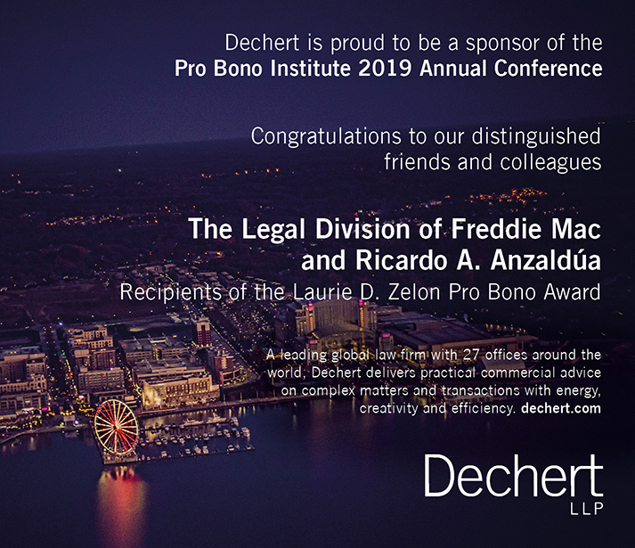
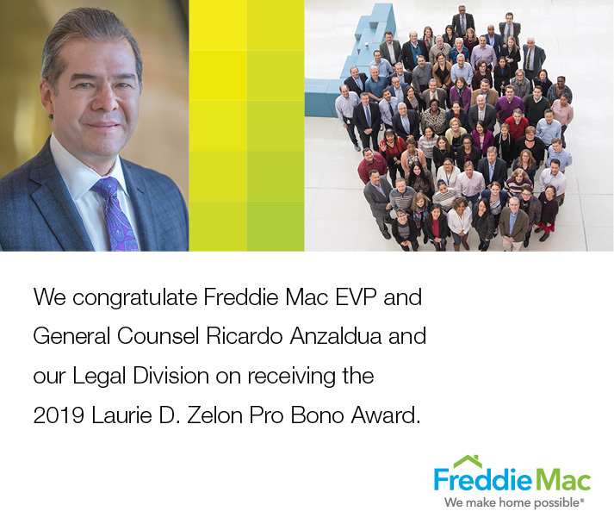

Slide 10
